Slide 1



PowerShell Techniques and Performance Tweaks
The Full Show
Christian Ritter
blackboxcoder
HCRitter
linktr.ee/hcritter

Slide 2


Slide 3
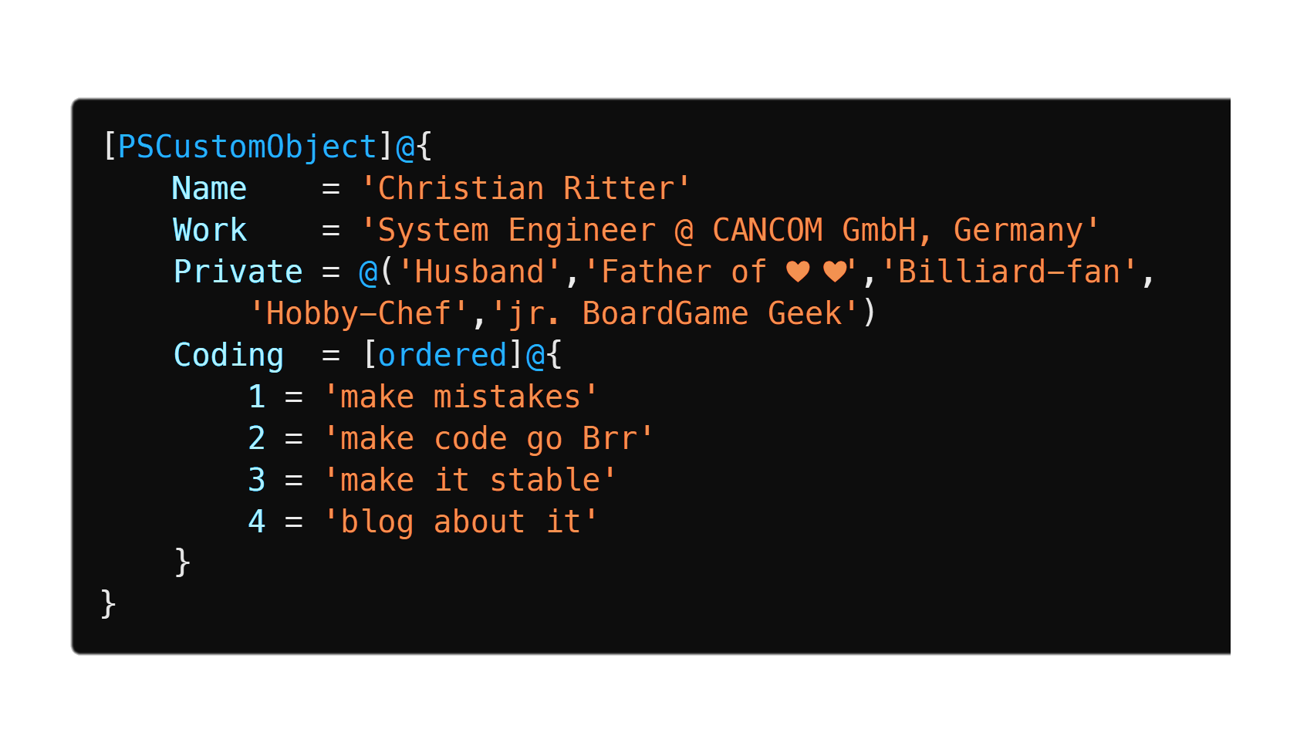
>_ (GET-Speaker).FullDetails

Slide 4
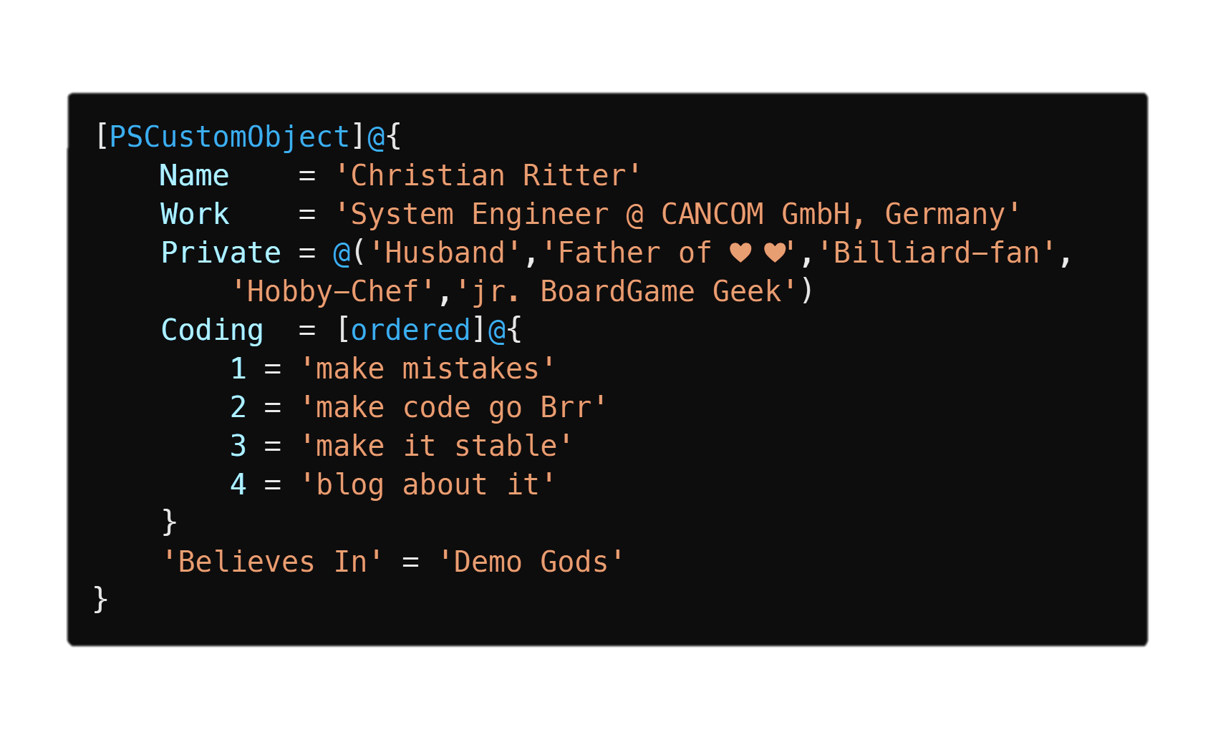
>_ | Add-Member -Type NoteProperty -Name ‘Believes in' -Value ‘Demo gods'

Slide 5
Disclaimer
If I am the smartest person in this room,
I am in the wrong room

Slide 6

Structure of the code
The good, the bad, and the ugly

Slide 7
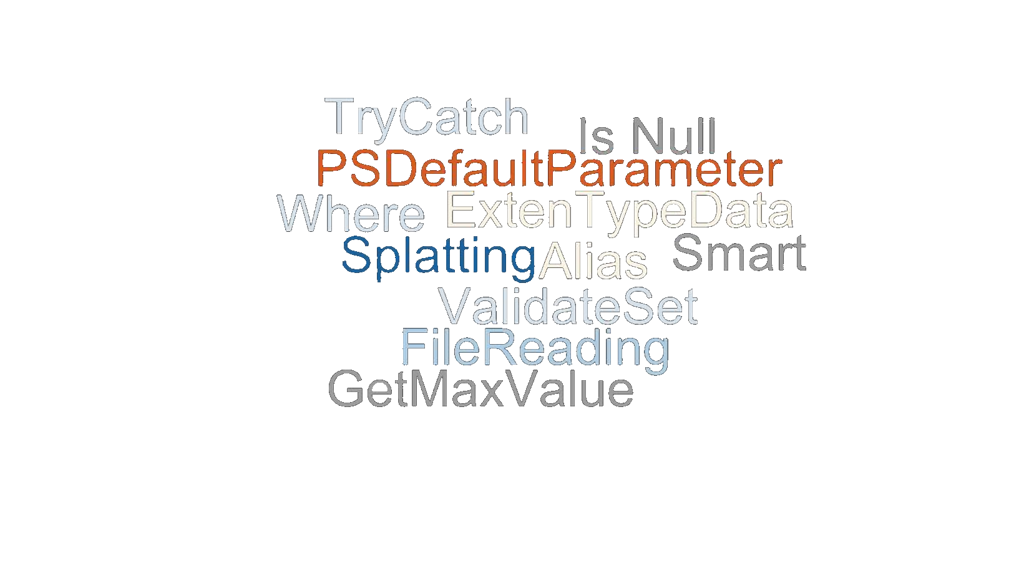

Slide 8
Technique Tweaks
How to make things easier, better, and more beautiful

Slide 9
Performance Tweaks
#region Simple demo example
$PSDefaultParameterValues = @{
"Install-Module:Scope" = "CurrentUser"
"Install-Module:AllowClobber" = $true
}
$PSDefaultParameterValues.Add("Export-Csv:NoTypeInformation", $true)
#endregion
How to make things go Brrr..

Slide 10

Let`s stay connected

Slide 11

THANK YOU
Please review this session

